Slide 1
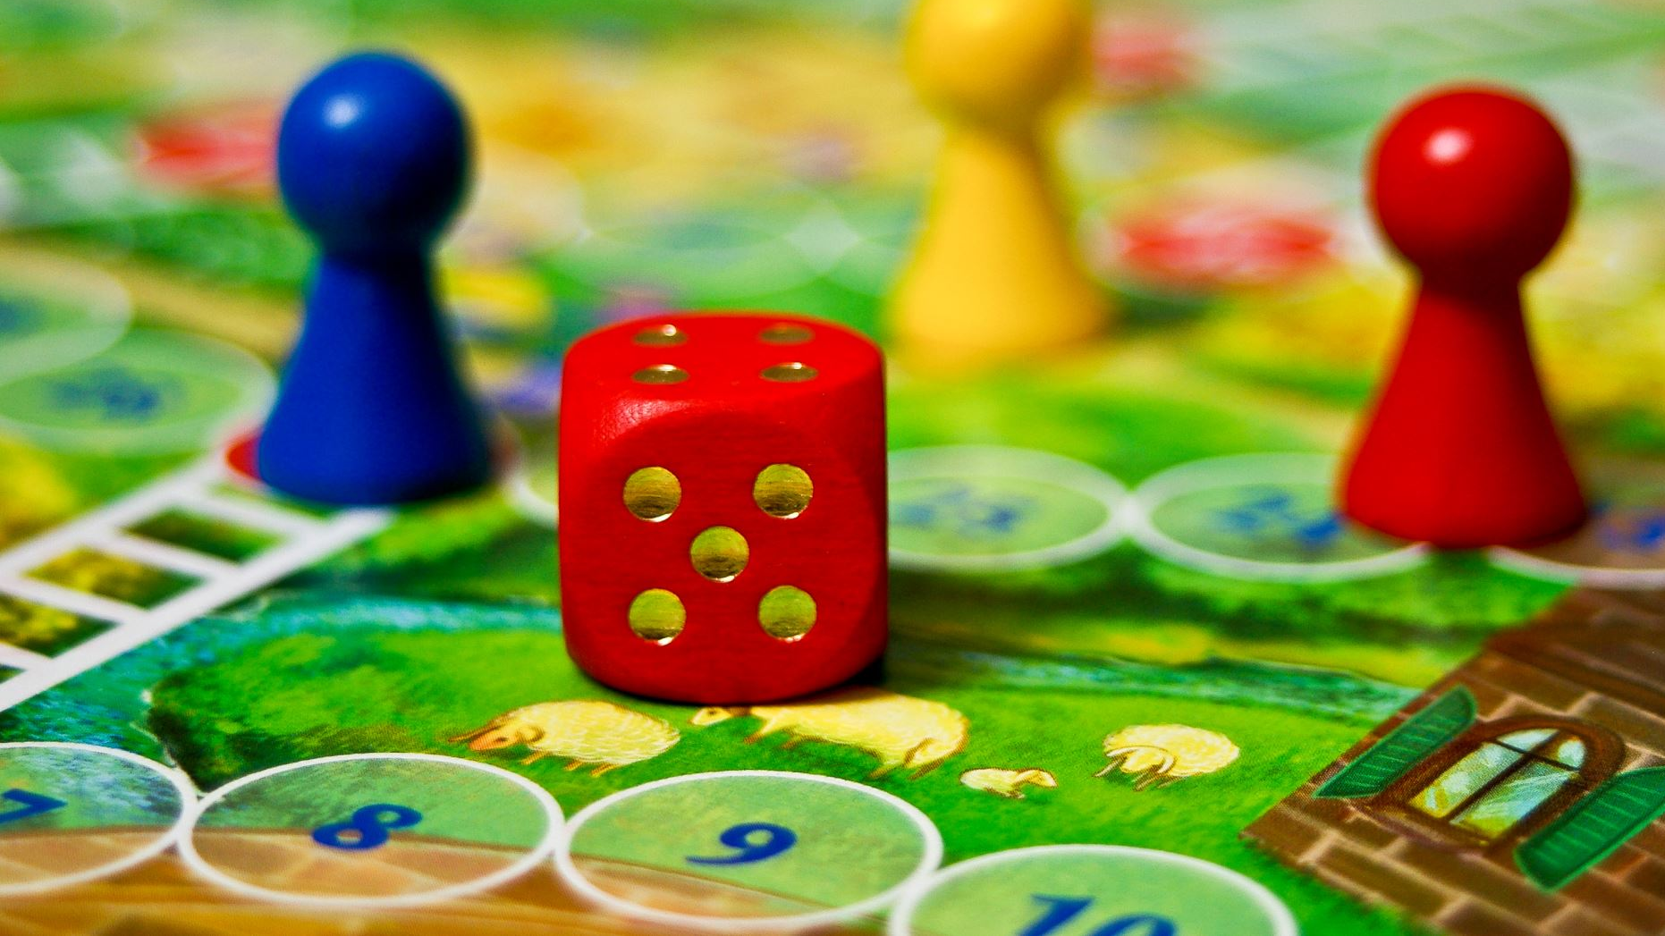
Matthew’s Journey: Godot Game Development
From Team NoGrads

Slide 2
Team NoGrads // Godot Game Project
Robert Dallessandris
BS Computer Science Senior
Team Role: Gameplay and Mechanics Developer
Virginia Richards
BS Computer Science Senior & Math minor
Team Role: Systems and Gameplay UI Developer
Josiah Yount
BS Computer Science Senior, Cybersecurity Certificate
Team Role: Narrative and Music Developer
Cara Zozokos
BA Computer Science, Cybersecurity Certificate
Team Role: Level and Menu UI Developer

Slide 3
Our Pitch
Godot programmed videogame named Matthew's Journey
2D top down, Zelda-like adventure game
With real-time hack and slash combat
2D pixel art, sound, & music will be outsourced
None of the team has made a game of this scope before
Notes:
Revise!!!!

Slide 4
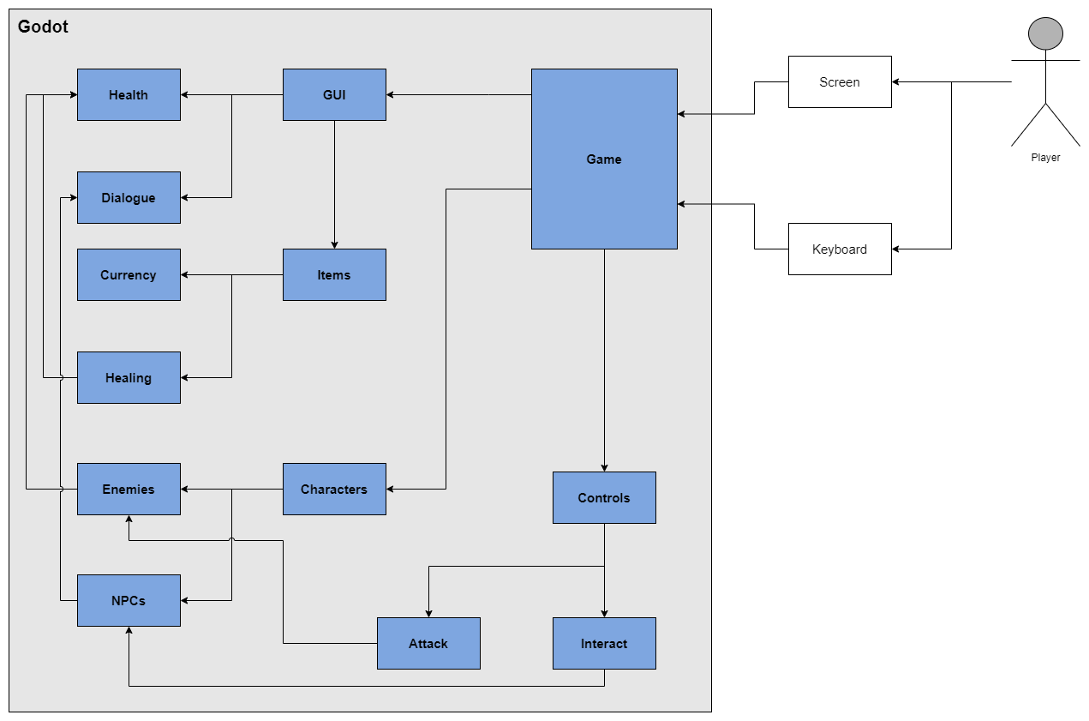
Overview
Combat (Robert)
Items (Virginia)
GUI (Josiah)
Map (Cara)
Notes:
Revise!!!!

Slide 5
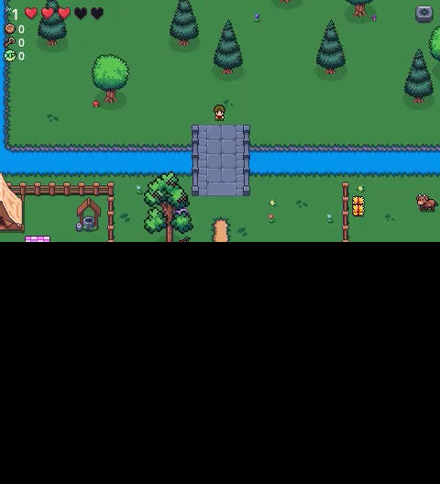
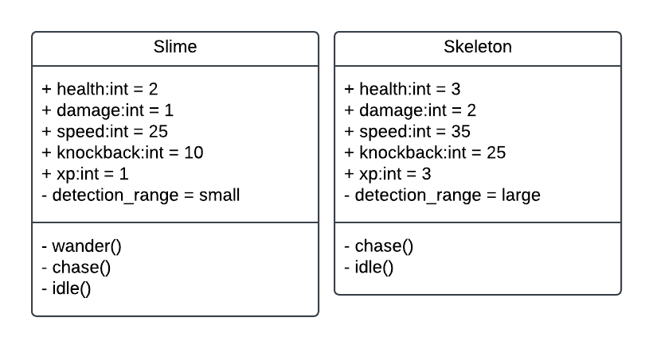
Combat
User Story: As a player, I want to be able move my character and swing my sword to fight enemies.
Requirement: There shall be enemies that are different enough to require different tactics.
Design:
Slimes: small detection zone, slow speed, low damage, low knockback, low xp, low health. They wander around until player gets in range then chase them. Meant to be an easy, common enemy.
Skeleton: Large detection zone, fast speed, high damage, high knockback, high xp, high health. They stand still until player gets in range then chase them. Meant to be an ambush enemy that hides behind trees to surprise player.
Conclusion: Simple hack and slash combat was implemented where the player swings a sword in the direction they are facing. The, two enemy types, slime and skeleton, present different challenges to the player
Notes:
Revise!!!!

Slide 6
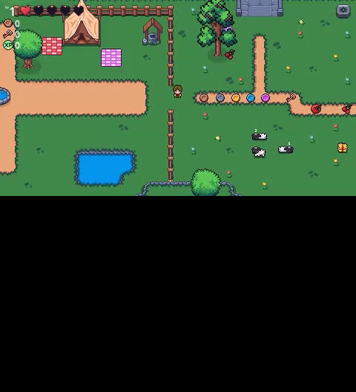
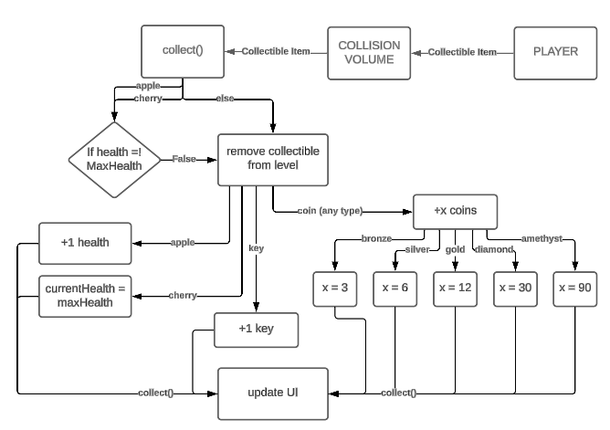
Items
User Story: As a player developer, I want elements in the environment for the player to interact with.
Requirement: There shall be items in the environment for the player to pickup
There shall be health pickups that will heal the players health
There shall be coin pickups
Design: All items are automatically taken (with the exception of health items) when the player touches them. The items contribute to a counter and when the counter is modified (ex: var current_blank_), the UI updates accordingly (ex: signal update_blank_).
Conclusion: There are two types of health pickup: apple that restores 1 health, and cherry that restores all health. Coins come in 5 different denominations and the total value is tracked in the HUD.
Notes:
Revise!!!!

Slide 7
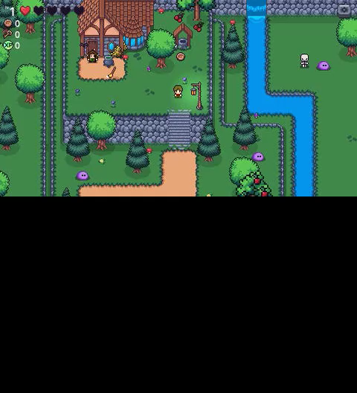
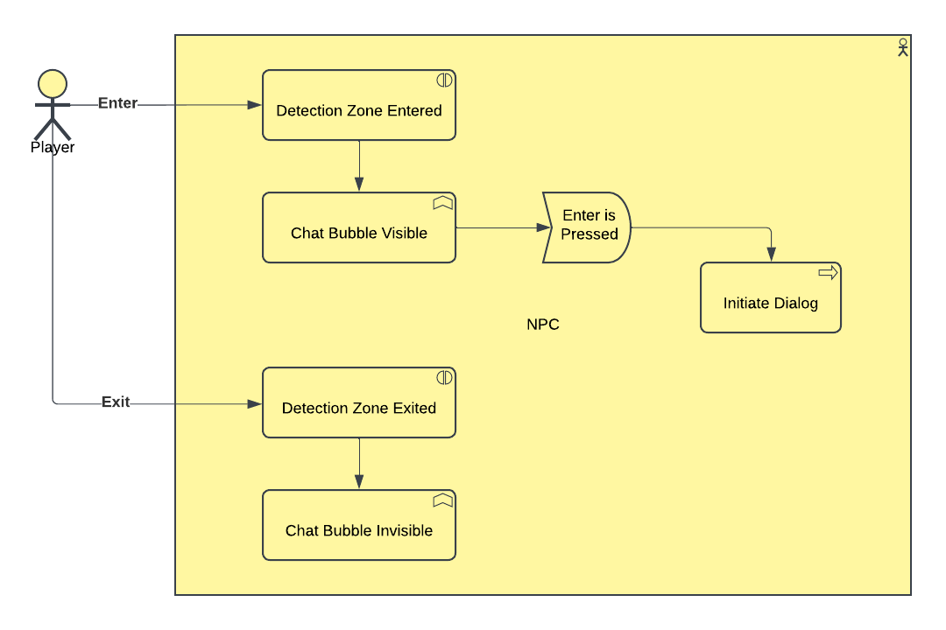
GUI
User Story: As a player, I want to interact with characters through dialogue boxes and understand how to play the game through those interactions.
Requirement: The characters shall have a dialogue mechanic.
Design: When the player approaches an npc they may talk too, a chat bubble will appear above the npc's head indicating the player is able to interact with this npc. Npc's have a detection zone around them that triggers the chat bubble icon's visibility. When a player character enters the zone the visibility is set to true, when the player exits the zone, the visibility is set to false. While within the zone, if the player presses enter, the dialog for that npc will be triggered.
Conclusion: Dialog is implemented through the Dialogic library. The player can select options when talking to an NPC that lead to differing results
Notes:
Revise!!!!

Slide 8
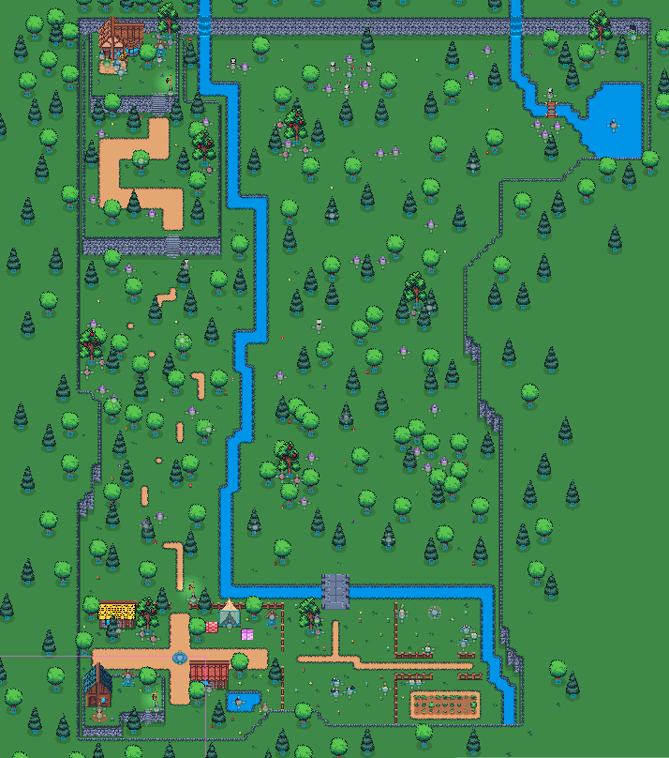
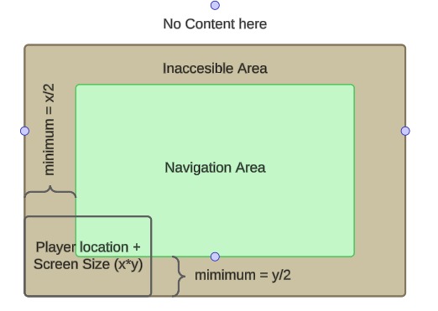
Map
User Story:
As a player, I want to navigate an environment that's easy to explore with collision that supports my movement and keeps me within bounds.
Requirement:
The play area shall have boundaries.
Design:
The player has a fixed camera that keeps the player body at the center of the screen at all times.
In order to not break immersion, it's important that the player does not see any blank space in the levels where there is no map.
To achieve this, there must be a playable area that the player can freely navigate which is enclosed. There will be another area that the player cannot access which functions as a decorative space to hide the edges of the level where the content ends.
The inaccessible area must be a minimum of half the height or width of the player camera to accurately hide the blank space.
Achieving this will create immersion and a cohesive game environment.
Conclusion:
The map is surrounded by cliffs that act as boundaries with collision so that the player cannot see off the map.
Notes:
Revise!!!!

Slide 9
Conclusion
Overall, the class went well!
Balanced time between learning and working
Guest speakers were fun and helpful in each of their own unique ways
Professor Cogan did a good job trying to make the class more fun and interactive
First class for a semester long group project for all of us
Taught us how working as a team can be both nice but difficult at times
Taught us how to work with the scope of a project in a specific time frame
Notes:
Revise!!!!

Slide 10
Questions?
Notes:
After 11 minutes

